Slide 1

Katie French

Slide 2
7-9 Outline
Revolution effects literature
  Poems and songs
    Become tools for patriotism!
      Yankee Doodle
    Philip Morin Freneau- boat captain, poet and news paper editor.
      Poem The House of Night one of the first romantic poems
      His writing was dark like edgar Allen Poe
      Considered a forefather of the Transcendentalist movement.

Slide 3
7-9 Outline Continued
  Satire
    Definition: genre aimed at provoking (or some say, preventing) change. Often uses outlandish examples to make people at themselves and notice an issue in society. Ranges from juvenalian, a non-threatening, light hearted and foolish tone to a Horatian tone- where death, human right violations and other horrible and tragic are mocked.
    John Trumbull
      Wrote satirical poems.
      Elements of romanticism and Neoclassic literature
        Neoclassic literature involved rationalism, classical imitation, good taste, formalism, and educational entertainment.

Slide 4
7-9 Outline Continued
    Francis Hopkinson
      had funny titles for his writing
        ‘The Miscellaneous Essays and Occasional Writings of Francis Hopkinson’
        A Pretty Story Written in the Year of Our Lord 1774
        Collection of Plain Tunes with a Few from Anthems and Hymns.
      Wrote essays, poems and even composed music!
      Claimed to have designed the first American flag

Slide 5
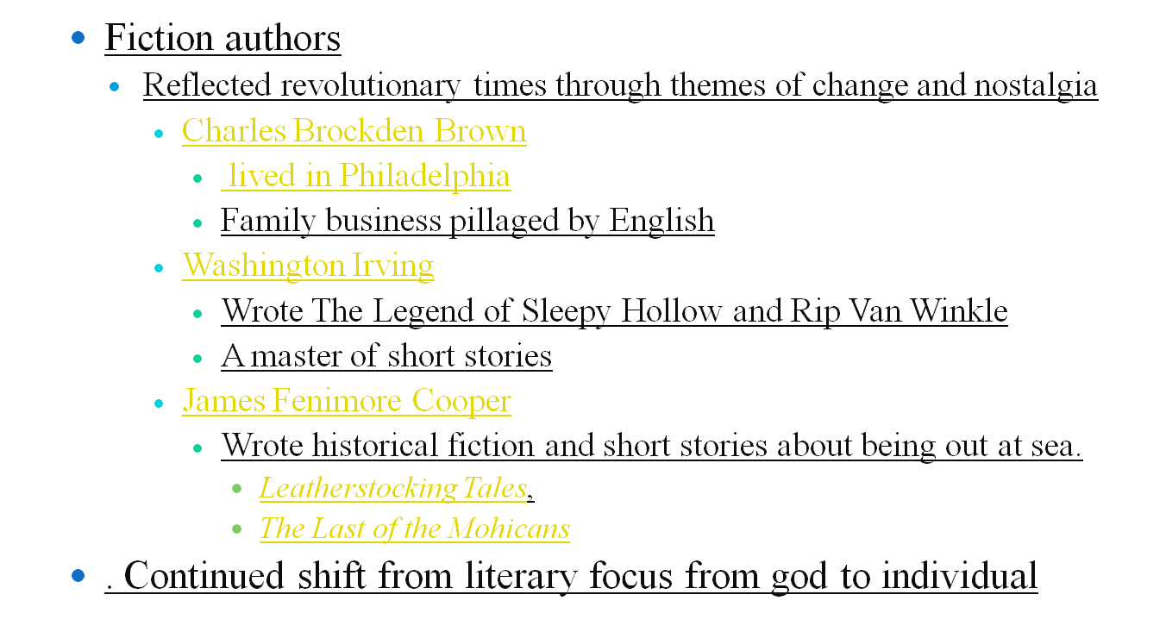
7-9 Outline Continued

Slide 6
7-9 Outline Continued
    Communities growing lead to a stronger interest in society and individuals
      In the past, small groups were generally together for religious reasons- as the population grew, communities became more diverse and interests varied- economic roles are key. This lead to church’s weakened power over community.
    After scientific understandings like the laws of physics, man becomes increasingly confident in their personal potential.
    Enlightenment ideas act as a linchpin
    Benjamin Franklin’s Autobiography instills idea man makes his destiny

Slide 7
2 important people
Benjamin Franklin- wrote under a fake name for much of his career. He had a talent in utilizing folk phrases in his works. He’s an important person because of the role his writings played in the turn from the church and towards individuals, as seen in his famous ‘the way to wealth’ as well as his autobiography.
Edgar Allen Poe- he was a huge leader in the romanticism movement and was an idol for many American authors with his very dark, detailed style of writing.

Slide 8

CH 7-9: 5 terms ADDED

Slide 9
10 Multiple Choice questions
1.Yankee doodle was a
  Song b. short story c. picture book d. slogan for the revolution
2.The enlightenment took place in
  Kenya b. Japan c. France alone d. Europe
3.Overtime, writing changed from being focused on theology to focusing on
  geography b. statistics c. gravity d. individuals power and choices

Slide 10
10 Multiple Choice Questions
4. True or false: Benjamin Franklin wrote a play called ‘As we’ve seen’, focused on American oppression by the british
  a.true b. false
5. What genre is Washington Irving best known for?
a. satire b. horror stories c. romanticism d. short stories
6. Which description is not related to Satire?
a. always meant to be performed on stage b. meant to poke fun of society c.meant to provoke change d. can address serious topics

Slide 11
10 Multiple Choice Questions
7. Who wrote The Last of the Mohicans?
a.Benjamin Franklin b. James Fenimore Cooper c. Charles Brockden Brown d. Washington Irving
8. Charles Brockden Brown wrote
a. satire b. fiction c. pamphlets d. philosophy
9. Which of the following did Francis Hopkinson not write?
a. essays b. epics c. composed music d. poems
10. Which author was a boat captain?
a. Charles Brockden Brown b. Francis Hopkinson c. Philip Morin Freneau d. John Trumbull

Slide 12
Answer key to ch 7-9 Multiple Choice Questions
1.A
2. D
3. D
4.B
5. D
6.A
7. B
8. B
9. B
10. C

Slide 13
CH 10 BEGINS
ON THE NEXT SLIDE- PREPARE YOURSELF

Slide 14
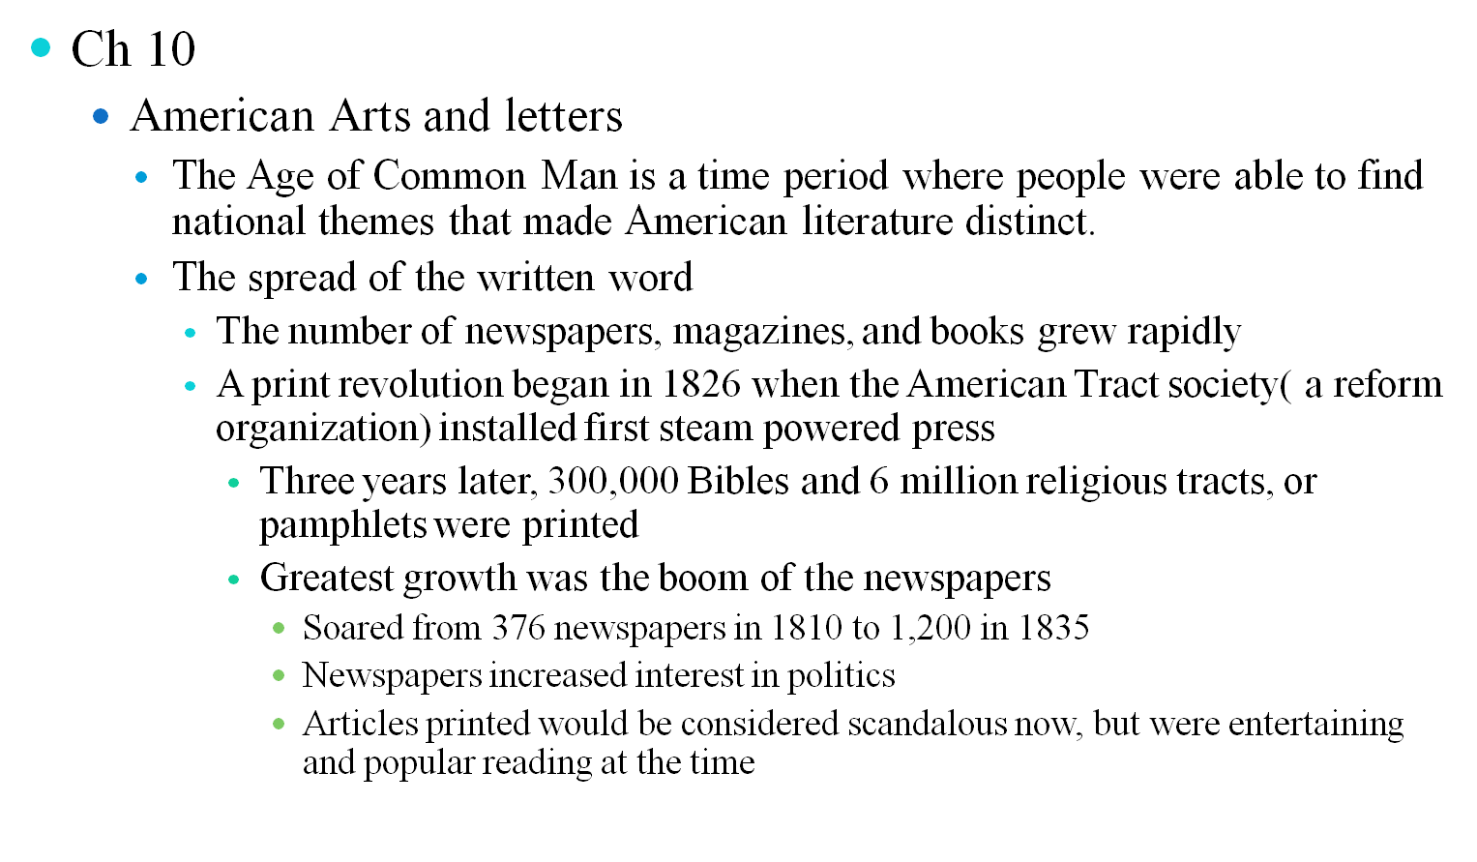
Ch 10-12: Outline

Slide 15
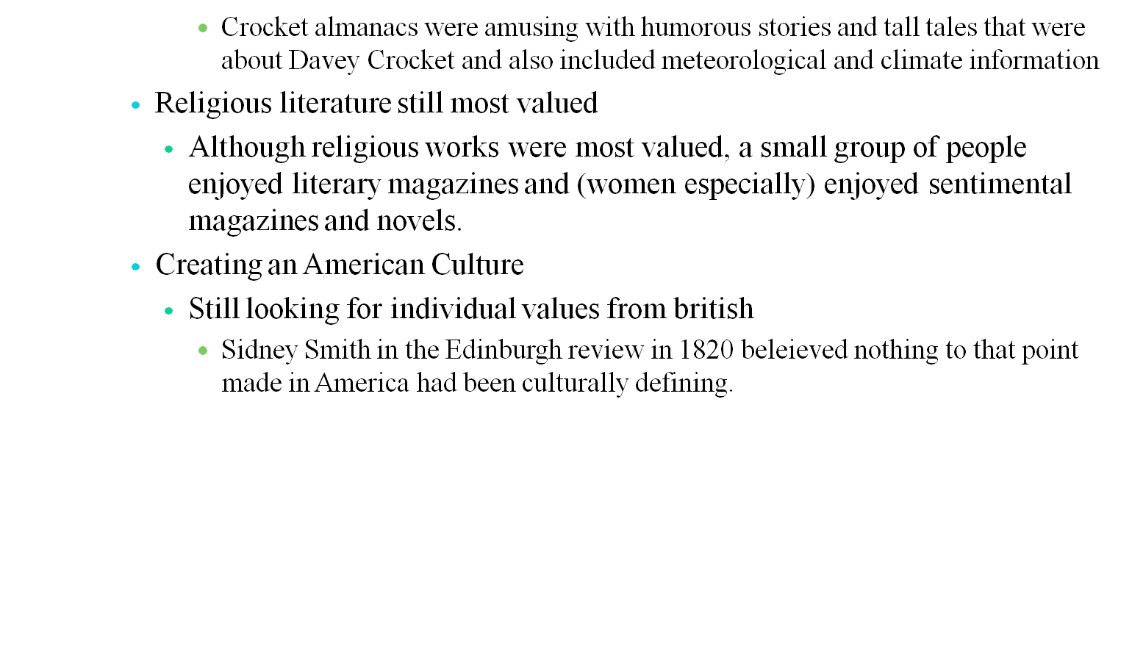
CH 10-12: Outline Continued

Slide 16
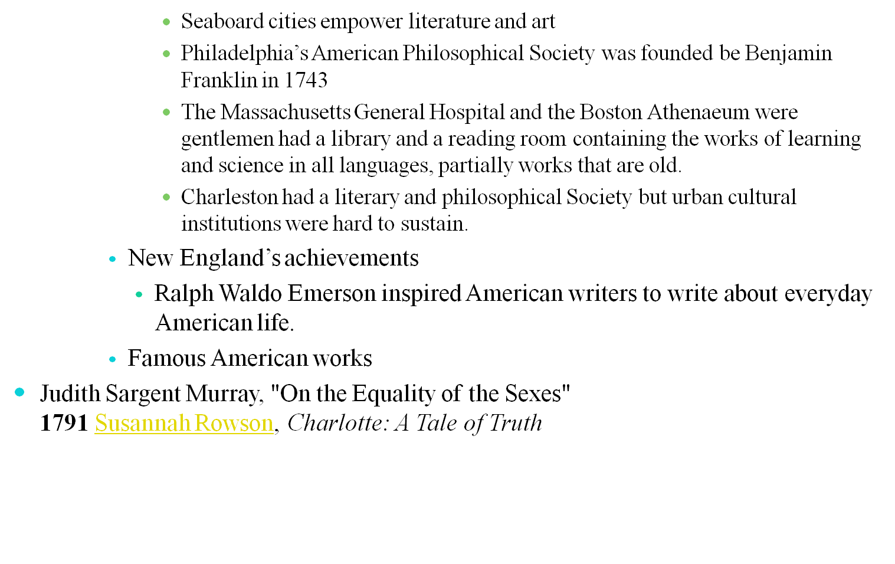
CH 10-12: Outline Continued

Slide 17
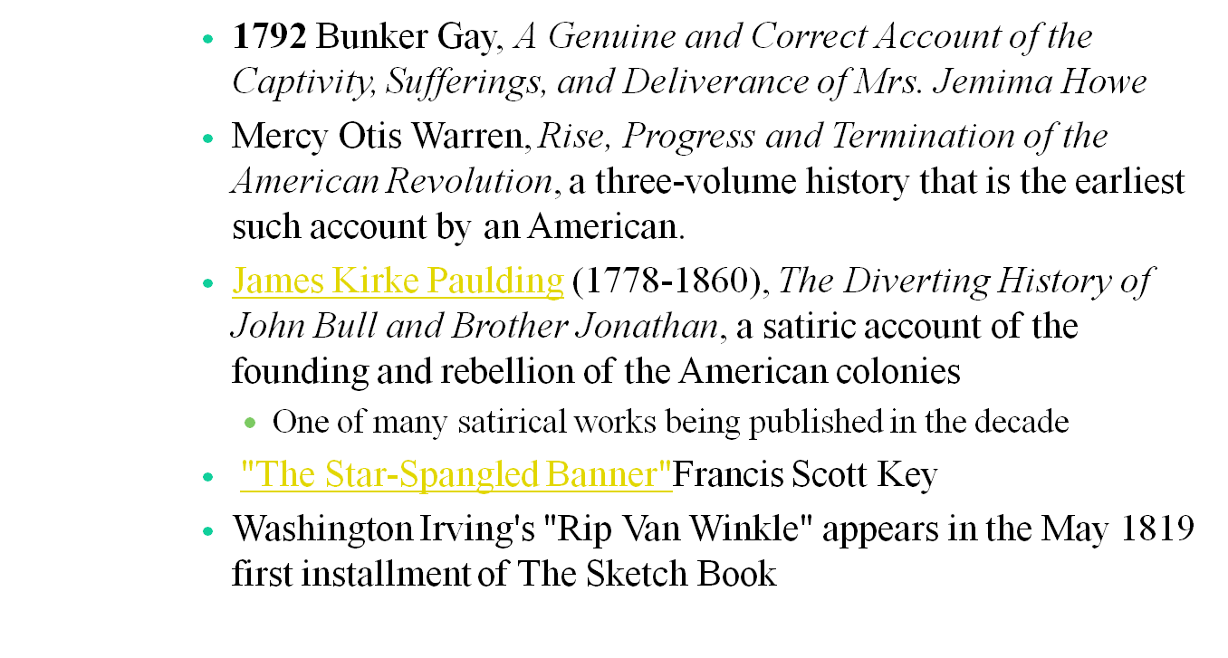
CH 10-12: Outline Continued

Slide 18
CH 10-12: Important Terms
2 Literary terms

Slide 19
CH 10-12: Multiple Choice
10 multiple choice questions
1.
2.
3.
4.
5.
6.
7.
8.
9.
10.

Slide 20
CH 13-15: Outline
Authors of the Time
  William Gilmore Simms
    Life
      was a poet, novelist and historian
      Edgar Allen Poe believed he was the best American novelist
    Works
      Martin Faber in 1833
      Guy Rivers in 1834
      The Yemassee in 1835
  Lydia Maria Child
    Life
      She was an American abolitionist, women's rights activist, opponent of American expansionism, Indian rights activist, novelist, and journalist and Unitarian.(Very busy!)
    Works
      Hobomok in 1824
      The Rebels in 1825

Slide 21
CH 13-15: Outline
  John Neal
    Life
      Author and art/literary critic as well as women's rights advocate, prohibitionist, temperance advocate, opponent of dueling, accomplished lawyer, boxer, and architect.
    Works
      Logan, A Family History in 1822
      Rachel Dyer in 1828
      The Down-Eaters in 1833
    Literary accomplishments
      He was the first American author to use colloquialism in his writing, making his writing less formal to the point of seemingly rambling at points
  Catherine Maria Sedgwick
    Life
      came from an important Federalist family in western Massachusetts
      Left Calvinism to become a tolerant Unitarian
      Very close to family, remained single and visited family frequently
    Works
      A New England Tale in 1822
      Redwood in 1824
      Hope Leslie in 1827
      The Linwoods in 1835

Slide 22
CH 13-15: Outline
  James Kirke Paulding
    Life
      He was an American writer and, United States Secretary of the Navy.
      Was very interested in idea of liberty and American culture
    Works
      The Lion of the West in 1830
      The Dutchman’s Fireside in 1831
      Westward Ho! in 1832
  Robert Montgomery Bird
    Life
      Graduated with a medical degree
      Wrote poems, plays and novels
      Known for documenting US History
    Works
      Calavar in 1834
      Nick of the Woods in 1837

Slide 23
CH 13-15: Outline
  James Fenimore Cooper
    Life
      He was an American novelist
      Focused on the subjects and landscape creating a vivid myth of frontier life.
    Works
    The Last of the Mohicans written in 1826.^{[8]}
Major Literary movements
  Romanism
    Definition
      Definition comes from Charles Baudelaire: "Romanticism is precisely situated neither in choice of subject nor exact truth, but in the way of feeling."
    Authors
      Edgar Allan Poe and Nathaniel Hawthorne, along with Emily Dickinson and Herman Melville's
    Key purpose
      emphasize intuition, imagination, and feeling

Slide 24
CH 13-15: Outline
  Transcendentalism
    Definition
      belief in an ideal spiritual state that "transcends" the physical and empirical and is realized only through the individual's intuition, rather than through the doctrines of established religions
    Authors
      Henry David Thoreau and Ralph Waldo Emerson
      Many supporters where deeply involved in Philosophy such as Kant
    Key purpose
      To convert relgion into spirituality- to make faith a deeply personal experience
      To connect people to deeper philosophical thoughts through nature observation- meditating on Ant pile could bring enlightenment

Slide 25
CH 13-15: 2 key terms/people
2 key people
Hawthorne- He was a Anti-transcendentalist who penned ‘The Scarlett letter’, which is considered one of the top ten literary works in America. Hawthorne was an introvert, was friends with Melville-author of Moby Dick- and spent over a decade researching his families Puritan Past.
Emerson- the leader of the Transcendentalist movement. He despised the material world and thought society could be fixed a person at a time- disliked consumerism. Believed meditation on nature could enlighten individuals.

Slide 26
CH: 13-15 Vocabulary
5 vocabulary terms
TABOO (also spelled tabu): (1) In anthropology, a taboo is a socially prohibited activity. For instance, in classical Greek culture, it was forbidden for a murderer or menstruating woman to enter the sacred space of a temple or the central agora of a city beyond a temenos boundary lest that action spread contagious miasma. (2) A linguistic taboo is a social prohibition that forbids mentioning a word or subject. Commonly, various cultures might have taboos against mentioning bodily fluids, defecation, certain sexual activities, or certain religious terms. These terms often suffer linguistic pejoration and become "curse-words." For instance, in Britain, the adjective bloody is considered taboo or impolite to speak aloud as a curse word because of its older religious connotations as a medieval curse about the blood of Christ's wounds. In American English, words describing specific sexual activities or bodily functions usually are taboo for polite conversation, and so on.
ROMANTICISM: The term refers to the artistic philosophy prevalent during the first third of the nineteenth century (about 1800-1830). Romanticism rejected the earlier philosophy of the Enlightenment, which stressed that logic and reason were the best response humans had in the face of cruelty, stupidity, superstition, and barbarism. Instead, the Romantics asserted that reliance upon emotion and natural passions provided a valid and powerful means of knowing and a reliable guide to ethics and living. The Romantic movement typically asserts the unique nature of the individual, the privileged status of imagination and fancy, the value of spontaneity over "artifice" and "convention," the human need for emotional outlets, the rejection of civilized corruption, and a desire to return to natural primitivism and escape the spiritual destruction of urban life. Their writings often are set in rural, pastoral or Gothic settings and they show an obsessive concern with "innocent" characters--children, young lovers, and animals. The major Romantic poets included William Blake, William Wordsworth, John Keats, Percy Bysshe Shelley, and Lord Gordon Byron. Contrast with Enlightenment. You can click here to download a PDF handout placing these periods of literary history in chronological order.

Slide 27
CH: 13-15 Vocabulary
TABULA RASA (Latin, "erased tablet"): The term used in Enlightenment philosophy for the idea that humanity is born completely innocent, without any initial predispositions, attitudes, or beliefs. Accordingly, no natural state of humanity exists, but instead, humanity is infinitely malleable. The newborn child is thus a "blank slate" on which experiences and education will write his or her future personality and beliefs. The idea is influential in the philosophical writings of Locke, Rousseau, and Wollstonecraft, but it also influences literary fiction such as Frankenstein, in which the monster's account of his experiences after his initial creation characterize him as an innocent tabula rasa.
TACTILE IMAGERY: Verbal description that evokes the sense of touch. See imagery.

Slide 28
CH 13-15: Multiple Choice
10 multi choice
1.)What is Romantism?
a.)Sappy writing b.) anything transcendentalist c.) poetry d.) a style of writing that promotes emotion and has a philosophical backing
2.) Who was the founder of the Transcendentalist movement?
a.)Henry Thoreau b.)Henry the VIII of England c.) Emerson d.) William Shakespeare
3.) Were Philosophy and Enlightenment ideas important and built upon during the time period examined?
a.)not at all b.)everything was philosophical c.)Many genres had philosophical underpinnings d.) only one famous writer during the 1840’s had used philosophy
4.) Were Transcendentalists focused on bettering the world through meditation?
a. absolutely not b. Somewhat c. definitely d. transcendentalists were required to mediate before lunch for 50 seconds e.) One of Transcendentalists hopes was to create a utopian society one person at a time

Slide 29
CH 13-15: Multiple Choice
5.) Identify the false statement
a.) Emerson supported violence b.) Moby dick was a book about a man chasing a whale c.) Many Philosophers were interested in transcendentalism or romanticism d.) some Romanists were anti-transcendentalists
6.) Romanticism is mostly concerned with
a. emotion b. logic c. math d. science
7.) Robert Montgomery Bird graduated from college with a degree in
a. medical related things b. political science c. art history d. people could only go to college for religious jobs, so he was trained to be a minister

Slide 30
CH 13-15: Multiple Choice
8.) Catherine Maria Sedgwick was a
a. Mormon-she founded the Church b. a life long Calvinist c. an American terrorist d. a Calvinist that became a Unitarian
9. John Neal was all of the following except
a. Author and art/literary critic b. women's rights advocate c. prohibitionist d. philosopher
10.) Edgar allen Poe loved:
a. Writer William Gilmore Simms b. happy stories c. his 20 daughters d. to wear eye liner

Slide 31
CH 13-15: Multiple Choice Answers
1.)d
2.)c
3.) c
4.) e
5.) a
6.)a
7.)a
8.)d
9.)d
10.) a

Slide 32
CH 16-17: Outline
Important Writers
  Mark Twain
    Called Samuel Langhorne Clemens
    Born in Missouri
    Wrote memoir Life on the Mississippi
    Wrote famous Novels Adventures of Tom Sawyer and Adventures of Huckleberry Finn.
    Style
      Influenced by journalism, an important form of Literature in his lifetime
      Wrote with honesty, frankness and humor
        Influenced future American writers diction and syntax
      His characters are a still shot of his time- he utilized local dialects, new words that were being invented in America, and accents to portray different American characteristics of speech.

Slide 33
CH 16-17: Outline
  Henry James
    Wrote about the Old World-New World dilemma
    Was born in New York City spent most of his adult years in England.
    Many of his novels center on Americans who live in or travel to Europe.
    Used intricate sentences and used emotion and description nuance, making his writing a little hard to understand
    Among his easier to read publishing’s are the novellas Daisy Miller, about an enchanting American girl in Europe
    The Turn of the Screw was about a ghost.
  Edith Wharton
    critiqued the upper-class, Eastern-seaboard society that she grew up in.
    Her book The Age of Innocence, centers on a man who chooses to marry a conventional, socially acceptable woman, instead of a mysterious woman.
  Stephen Crane
    best known for his Civil War novel The Red Badge of Courage
    focused on the life of a prostitute in Maggie: a girl of the streets
  Theodore Dreiser
    Wrote Sister Carrie, which was about a country girl who moves to Chicago and becomes ‘a kept woman.’

Slide 34
CH 16-17: Outline
  Hamlin Garland
    Focused on issues with farms and social issues
  Frank Norris
    Also focused on naturalism to express concerns for the lives of farmers and social issues
    Other Popular books and authors of the time
  Great Expectations - Charles Dickens
    Is written very wordy- incredibly descriptive
  Anna Karenina - Leo Tolstoy
  Black Beauty - Anna Sewell
  Around the World in 80 Days - Jules Verne
    Adventure based

Slide 35
CH 16-17: Outline
  The Birth of Tragedy - Friedrich Nietzsche
    Philosophical- still highly popular
  Through the Looking-Glass - Lewis Carroll
    Part of the Alice in Wonderland phenomenon
  War and Peace - Leo Tolstoy
  Little Women - Louisa May Alcott
    Shows what womanhood was like through focusing on a large family and the experiences of close sisters
  Crime and Punishment - Fyodor Dostoevsky
  Alice's Adventures in Wonderland - Lewis Carroll
  Our Mutual Friend - Charles Dickens

Slide 36
CH 16-17: Outline
  From the Earth to the Moon - Jule Vernes
    Adventure
  Journey to the Center of the Earth - Jules Verne
    Adventure based
  Les Misérables - Victor Hugo
    Very famous- focused on French culture
Important Movement
  Authors use local language
    George W. Cable, Thomas Nelson Page, Joel Chandler Harris, Mary Noailles Murfree (Charles Egbert Craddock), Sarah Orne Jewett, Mary E. Wilkins Freeman, Henry Cuyler Bunner, and William Sydney Porter (O. Henry).

Slide 37
CH 16-17: Outline
  Realism
    Realism was most influential in terms of set design and staging
    Realism reflected the effects of the Civil War
    James Herne's Margaret Fleming tried to create a realism based drama to discuss issues of social determinism through realistic dialogue, psychological insight and symbolism
      the play was not a success, as critics and audiences alike felt it dwelt too much on unseemly topics and included inappropriate scenes

Slide 38
CH 16-17: Outline
    Authors include: Charles W. Chesnutt (African American), of María Ruiz de Burton, one of the earliest Mexican American novelists to write in English, and in the Yiddish-inflected works of Abraham Cahan.
    William Dean Howells wrote in a realist style through his novels The Rise of Silas Lapham as well as his job being the editor of and the Atlantic Monthly.
Also focused on local color regionalism , portraying minority experiences

Slide 39
Important terms
Colloquialism- A word or expression acceptable in informal usage but inappropriate in formal discourse. Colloquialisms give a work a conversational, familiar tone. Colloquial expressions in writing include local or regional dialects.
Cumulative Sentence- Also called a loose or running sentence. Sentence which achieves grammatical completeness at the start, then lets the details accumulate afterwards, after the basic sentence has already closed
Description – A rhetorical mode used to develop an essay whose primary aim is to depict a scene, person, thing, or idea. Descriptive writing evokes the look, feel, sound, and sense of events, people, or things.

Slide 40
Important terms
Realism -- An adherence to the facts, both is visual art and literature. The realists believed in the mimetic theory of art which stipulates that art must duplicate life.
Dialect -- The difference in speech of people speaking the same language, usually a regional difference.
Diction – Word choice. One of the components that make up a writer’s style.

Slide 41
Multiple choice questions
Who wrote Great Expectations?
  Unknown b. Charles Dickens c. Dickens Charles d. dialect
What did Lewis Carroll write?
  The story of helmsdeep b. the idea and dissection of crime and punishments c. Alice in Wonderland d. Paramour
Fyodor Dostoevsky wrote:
  Alice in wonderland b. the first romantic novel ever written c. a updated version of Athena’s original diary d. Crime and Punishment
What does the following describe? An adherence to the facts, both is visual art and literature. The realists believed in the mimetic theory of art which stipulates that art must duplicate life.
  Abstract writing b. Policy discussion c. realism d. diction

Slide 42
CH: 16-17 Multiple choice questions
What does the following describe? Word choice. One of the components that make up a writer’s style.
  Abstract writing b. Policy Discussion c. realism d. diction
Why did Americans use casual language?
  It portrayed the public correctly b. Publishing companies would edit things last minute c. Authors didn’t write well d. People found proper grammar to go against ideas about patriotism
Who wrote Novels Adventures of Tom Sawyer and Adventures of Huckleberry Finn?
  Tom Sawyer b. Huckleberry Finn c. Abe Lincoln d. Mark Twain

Slide 43
CH: 16-17 Multiple choice questions
Which war influenced writing MOST during this time period?
  The civil war b. Darfur c. WW 2 d. WW1
What famous book focuses on growing girls?
  Huckleberry Fin b. Mark Twains works c. Little Women d. James Herne's
What did Edith Wharton write about primarily?
  Childhood Memories b. the issues in the culture she’s grown up in c. Crime and Punishments d. People enslaving African Americans

Slide 44
CH: 16-17Multiple choice answers
B. Charles Dickens
C. Alice in Wonderland
D. Crime and Punishment
C. Realism
D. Diction
A. It portrayed the American public correctly
D. Mark Twain
A. Civil War
C. Little Women
B. the issues in the culture she’s grown up in

Slide 45
REFRENCES!
Faragher, J.M, Buhle, M.J., Czitrom, D.s, & Armitage, S.H. (2002). Out of Many: A History of the American People (revised third edition). Upper Saddle River, New Jersey: Prentice Hall.

